Slide 1
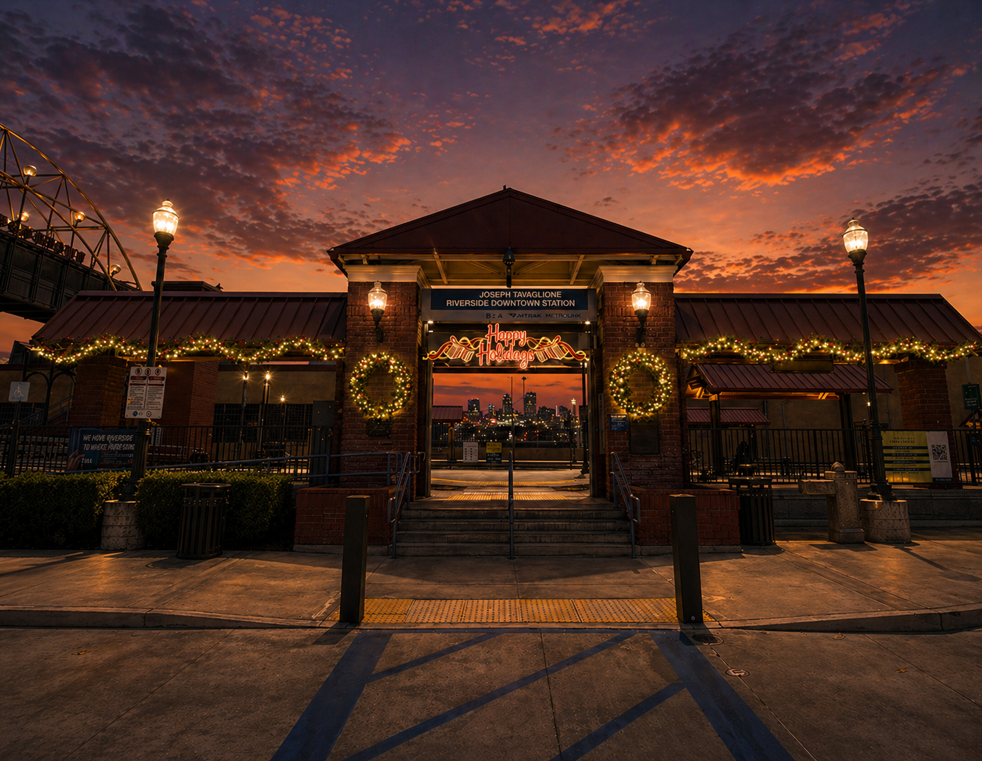
ST. NICK'S
CHRISTMAS LIGHTING & DÉCOR
2026 HOLIDAY SEASON
Riverside
Downtown Metrolink
PREPARED BY
St. Nick's Christmas Lighting & Décor
Proposal Date: April 30, 2026

Slide 2
ST. NICK'S
CHRISTMAS LIGHTING & DÉCOR
OWNER / GM
MARKETING
Executive Summary
FINANCE
Our 2026 holiday program for the Downtown Riverside Metrolink Station, at a glance.
AT A GLANCE
St. Nick's is proposing a transit-scale holiday program for the Downtown Riverside Metrolink Station — a designed, fabricated, installed, and serviced lighting and décor experience that anchors RCTC's flagship station as a downtown destination during the holiday season.
Our approach builds a signature visual identity for the station — driving ridership during peak season, creating shareable photo moments for the City of Riverside, and establishing a multi-year tradition that extends across the entire transit footprint.
PROJECT
2026 Holiday Program
ZONES
3 Zones · See pp. 5-7
RECOMMENDED TIER
Enhanced
INVESTMENT RANGE
$89K — $200K
GO LIVE
Fri, Nov 27, 2026
FABRICATION LOCK
Aug 28, 2026
Turnkey Delivery
Destination Scale
25 Years at It
SIGNING DEADLINE
Jul 31, 2026
Concept through teardown — one partner, zero seams.
Built for civic-scale destinations and transit hubs.
From Pier 39 to Disney Parks — and now Riverside.
ST. NICK'S · 2026 HOLIDAY PROPOSAL · RIVERSIDE-DOWNTOWN METROLINK
2 / 13

Slide 3
ST. NICK'S
CHRISTMAS LIGHTING & DÉCOR
OWNER / GM
MARKETING
Our Understanding
Playback of discovery — so we're all working from the same page.
VENUE & CONTEXT
GOALS FOR 2026
The Joseph Tavaglione Riverside Downtown Metrolink Station is RCTC's flagship Inland Empire transit hub — connecting Riverside, San Bernardino, and the LA basin. The station serves as the eastern gateway to downtown Riverside, anchoring civic identity and supporting peak holiday-season commuter and visitor traffic.
Establish the station as Riverside's premier holiday transit destination. Drive ridership through the holiday window, create shareable photo moments, and position the station as a year-after-year civic landmark for the City of Riverside.
KEY CONSTRAINTS
WHAT SUCCESS LOOKS LIKE
Active station — install must avoid disrupting commuter and bus operations. Power coordination with RCTC facilities required. Canopy lighting installed as 'invisible' work prior to Nov 1 and energized at go-live. Compliance with prevailing-wage / certified-payroll obligations as applicable.
A signature transit-holiday identity that photographs and shares well; measurable lift in station traffic and downtown engagement; a program built for multi-year refresh and integration with the City of Riverside's broader downtown holiday narrative.
ST. NICK'S · 2026 HOLIDAY PROPOSAL · RIVERSIDE-DOWNTOWN METROLINK
3 / 13

Slide 4
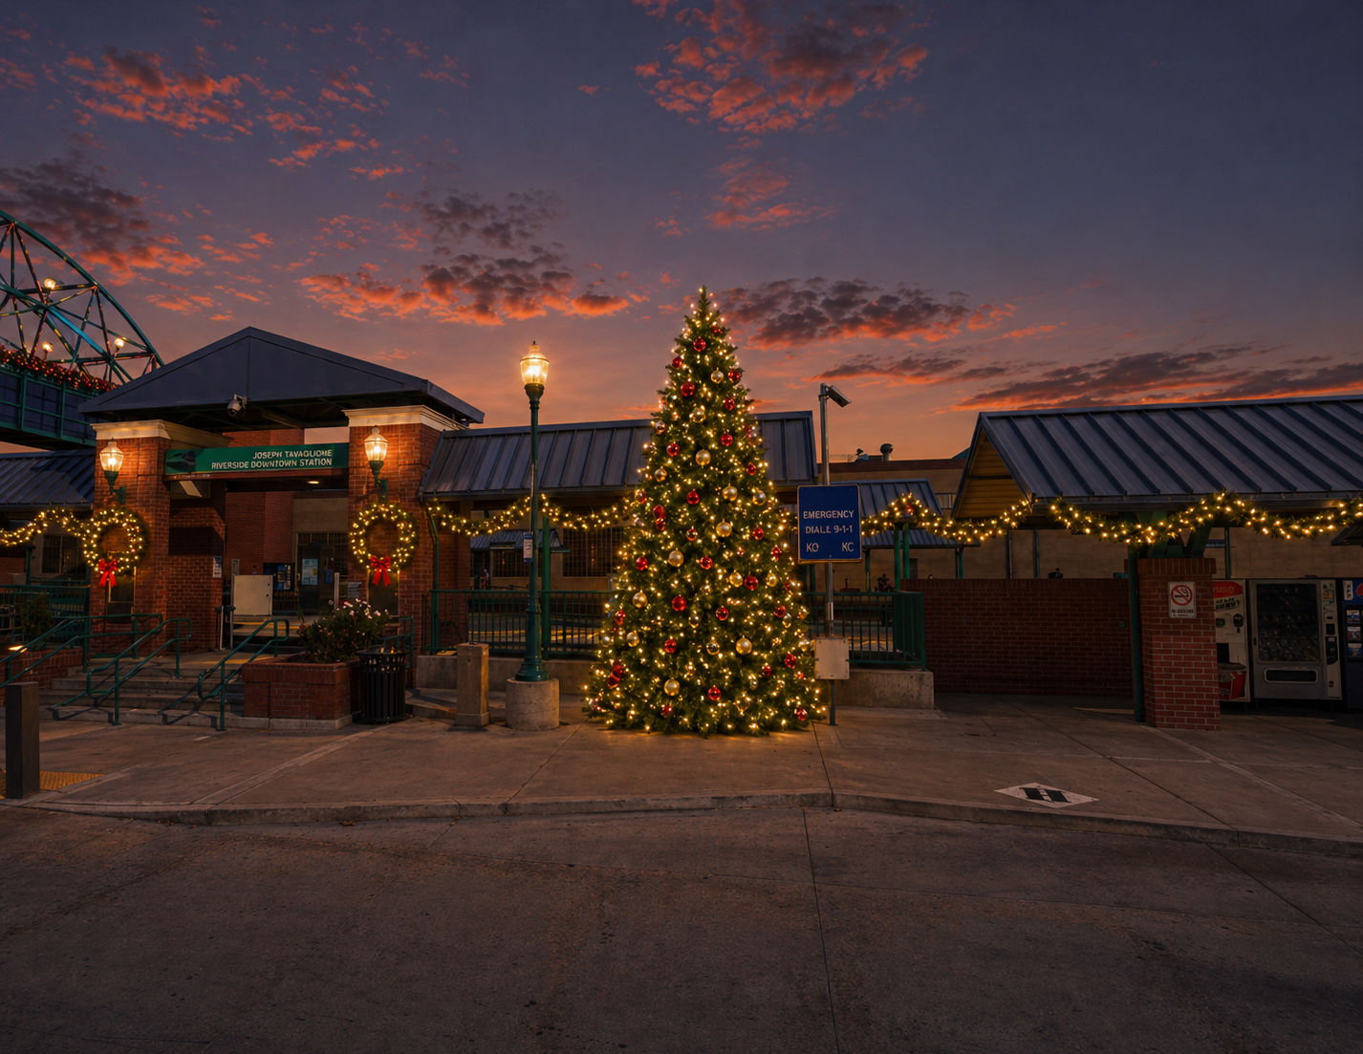
ST. NICK'S
CHRISTMAS LIGHTING & DÉCOR
MARKETING
Creative Vision
The design direction for Riverside's 2026 holiday program.
DESIGN DIRECTION
Holiday Express.
A warm, classic holiday aesthetic anchored to the station's iconic 'Holiday Express' train artwork — warm-white string lights, pine garland with red/green/gold ornaments, and oversized centerpiece moments that turn an active transit station into a photo-worthy destination from arrival through the platforms.
ARRIVE
EXPLORE
CELEBRATE
Warm-white welcome at the station entrance.
Garland and lighting layered across platforms and perimeter.
Signature centerpiece + photo-op features.
ST. NICK'S · 2026 HOLIDAY PROPOSAL · RIVERSIDE-DOWNTOWN METROLINK
4 / 13

Slide 5
ST. NICK'S
CHRISTMAS LIGHTING & DÉCOR
ZONE 01
Station Arrival & Plaza
First impression. The heart of the station experience.
INCLUDED ELEMENTS
• 35 holiday pole banners ('Board The Holiday Express' artwork) site-wide • 18' traditional Christmas tree centerpiece (red/green/gold ornaments) • Walk-through warm-white lighted ornament — bus loading island • 144 LF of decorated garland on building eave • Four 5' lighted wreaths between station entrance brick columns • 10' lighted wreath on stair tower column
ST. NICK'S · 2026 HOLIDAY PROPOSAL · RIVERSIDE-DOWNTOWN METROLINK
5 / 13

Slide 6
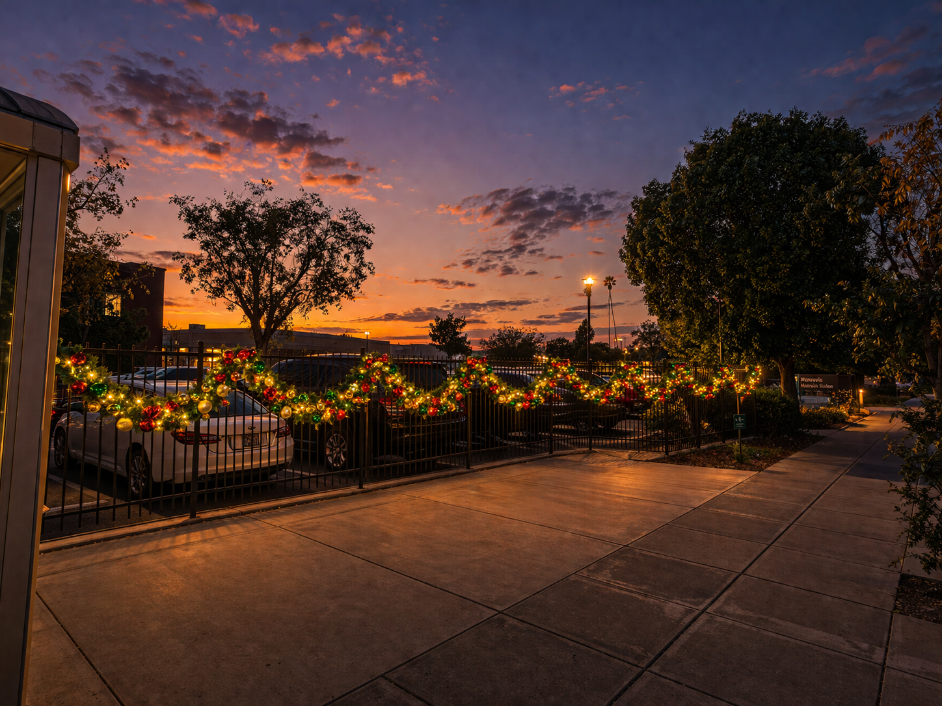
ST. NICK'S
CHRISTMAS LIGHTING & DÉCOR
ZONE 02
Platforms & Perimeter
The framing — lighting and garland that wraps the entire site.
INCLUDED ELEMENTS
• 1,258 LF of warm-white canopy string lighting (16 platform canopies + 2 bus stop canopies) • 621 LF of decorated swag garland — front gate / perimeter fence • 261 LF of decorated swag garland — center driveway gates • 207 LF of decorated swag garland — staircase tower & railing • 12 lighted snowflakes on platform railings (animated twinkle) • Canopy lighting installed pre-Nov 1 as 'invisible work' to minimize transit disruption
ST. NICK'S · 2026 HOLIDAY PROPOSAL · RIVERSIDE-DOWNTOWN METROLINK
6 / 13

Slide 7
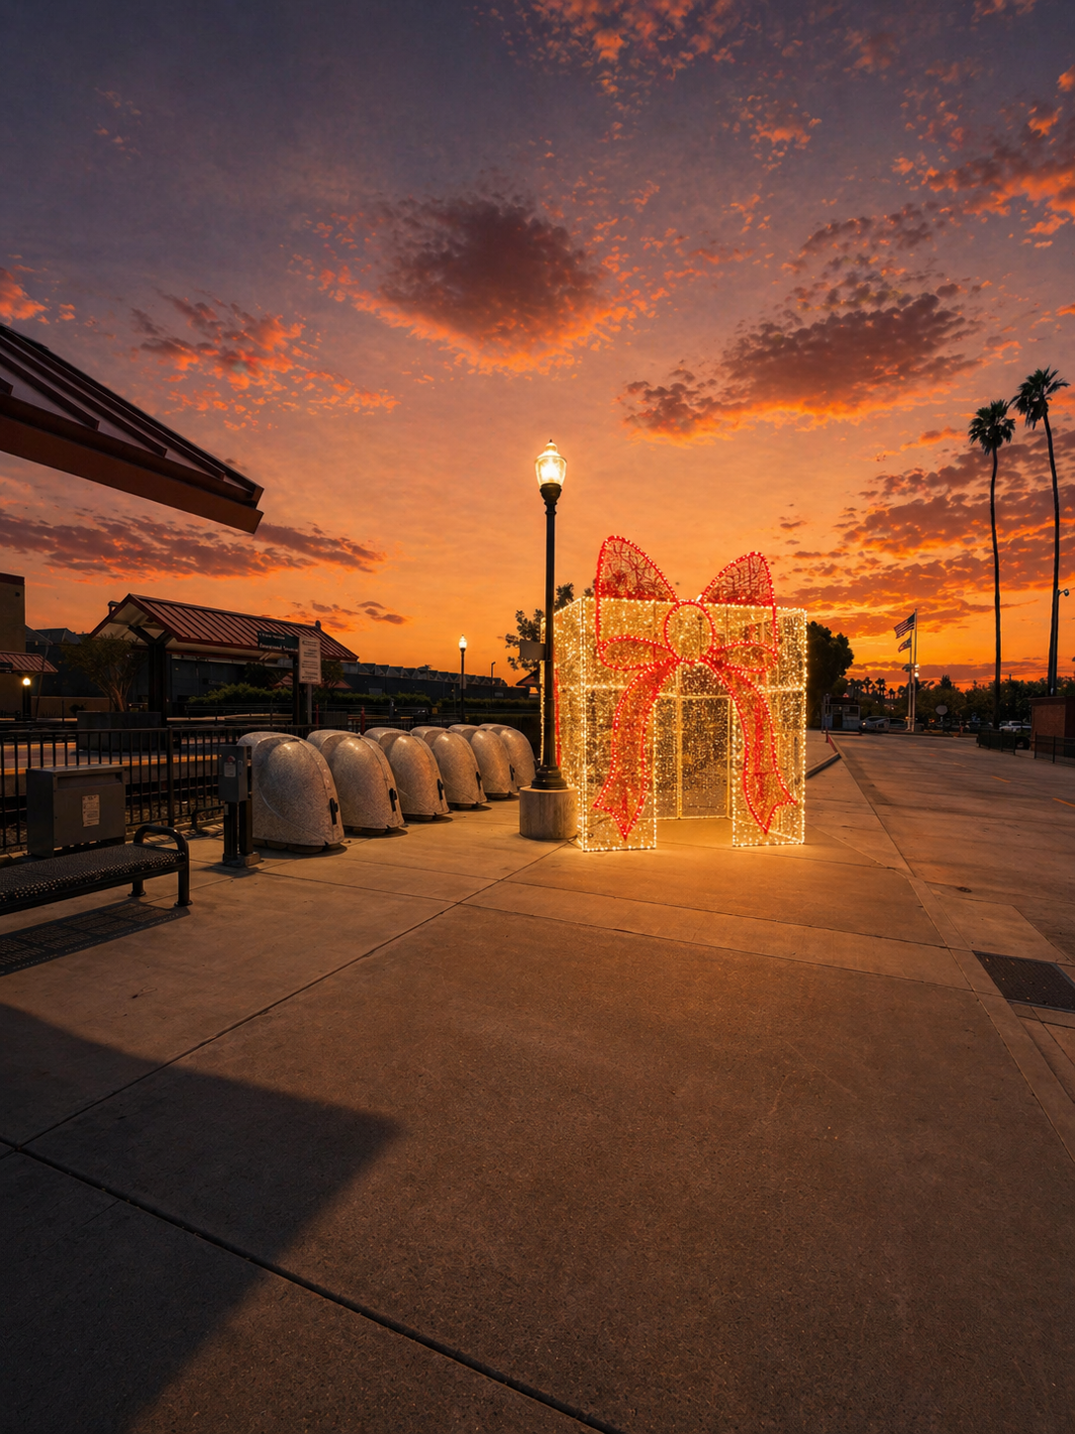
ST. NICK'S
CHRISTMAS LIGHTING & DÉCOR
ZONE 03
Custom Photo Moments
The wow features — custom-fabricated photo anchors that put RCTC on the map this season.
• Custom 'City of Riverside' lighted bell display (warm-white LED + rope light, PVC mesh) • 12' walk-through lighted gift box archway with red bow accent • Illuminated 'Happy Holidays' skyline sign at station entrance
• Lighted gift box tower (Signature tier — added at new location) • Spiral LED tree centerpiece option (Signature tier — replaces traditional tree)
7 / 13

Slide 8
ST. NICK'S
CHRISTMAS LIGHTING & DÉCOR
FINANCE
OWNER / GM
Scope of Work
What your investment includes, and what you can add on.
YOUR PROGRAM INCLUDES
OPTIONAL ADD-ONS
• Creative design + client-approved renderings • All materials, décor, and lighting elements • Full installation labor (phased, transit-aware schedule) • Power, electrical tap-ins, GFCI protection, timers • Testing, commissioning, and launch night support • Mid-season maintenance visits (Nov 27 – Jan 6) • Season on-call response • Complete post-season teardown and removal • Off-season storage of all rental elements at our facility
• Lighted snowflakes on railings +$3.5K • Walk-through gift box archway +$11.5K • Happy Holidays skyline sign +$3.2K • Decorated garland upgrade (Front Gate) +$26.7K • Decorated garland upgrade (Building Eave) +$6.6K • Decorated garland upgrade (Center Driveway) +$11.2K • Staircase tower & railing garland (decorated) +$14.9K • Custom 'City of Riverside' bell display +$18.8K Y1 • Lighted gift box tower (new location) +$11.1K • Spiral LED tree (replaces traditional) +$3.7K Δ • Multi-year partnership See Investment
ST. NICK'S · 2026 HOLIDAY PROPOSAL · RIVERSIDE-DOWNTOWN METROLINK
8 / 13

Slide 9
ST. NICK'S
CHRISTMAS LIGHTING & DÉCOR
CASE STUDY
Oregon Zoo · ZooLights 2025
Transforming Portland's family destination into a signature winter experience.
THE CHALLENGE
Deliver a full property-wide holiday transformation across 64 acres of active zoological habitats, with zero disruption to animal welfare and a firm Thanksgiving Day go-live.
OUR APPROACH
[Oregon Zoo — hero photo from ZooLights install]
Phased 18-night install coordinated with animal care teams. Custom low-impact lighting specifications. A signature 45-ft illuminated evergreen at the main entrance visible from Highway 26.
THE OUTCOME
31% YoY increase in ZooLights attendance. 4.2M+ social impressions. Partnership renewed through 2028. Feature coverage in The Oregonian and KGW.
ST. NICK'S · 2026 HOLIDAY PROPOSAL · RIVERSIDE-DOWNTOWN METROLINK
9 / 13

Slide 10
ST. NICK'S
CHRISTMAS LIGHTING & DÉCOR
FINANCE
OWNER / GM
Investment
Three levels of program. Pick what fits your season.
★ RECOMMENDED ★
ENHANCED
ESSENTIAL
SIGNATURE
FULL HOLIDAY PROGRAM
CORE HOLIDAY PRESENCE
DESTINATION-SCALE
• Everything in Essential, plus: • Decorated garland (red/green/gold) • Lighted snowflakes on railings • Walk-through gift box (photo op) • Happy Holidays skyline sign • Decorated staircase garland
• Base scope only — undecorated • 35 pole banners + brackets + install • 1,258 LF canopy string lighting • Garland — Front Gate, Eave, Driveway • Wreaths at entrance + stair tower • Traditional tree + walk-through ornament
• Everything in Enhanced, plus: • Custom 'City of Riverside' bell display • Spiral LED tree (replaces traditional) • Lighted gift box tower (new location) • Premium photo-op + signature features
$88,906
$166,643
$200,249
ALL-IN · TAX EXCLUDED
ALL-IN · TAX EXCLUDED
ALL-IN · TAX EXCLUDED
MULTI-YEAR PARTNERSHIP
2-YEAR
3-YEAR
5-YEAR
Lock in rates and save:
4% OFF
6% OFF
9% OFF
WHAT'S INCLUDED BY TIER: Base scope (banners, canopy lighting, garland, wreaths, tree, walk-through ornament) is in all tiers · Decorated garland upgrade + 4 enhancements added in Enhanced · Bell Display + Spiral LED Tree (replaces traditional) + Gift Box Tower added in Signature
Pricing valid 30 days from proposal date. Fabrication must be locked by Aug 28, 2026.
10 / 13

Slide 11
ST. NICK'S
CHRISTMAS LIGHTING & DÉCOR
FINANCE
Terms & Next Steps
The critical dates and terms for the 2026 program.
⚑ CRITICAL DATES
SIGNING DEADLINE
Execute by this date to guarantee the install schedule.
FABRICATION LOCK
All custom fabrication must be approved by this date (90 days pre-Go Live).
July 31, 2026
August 28, 2026
PAYMENT SCHEDULE
INSURANCE & PERMITS
50% deposit upon contract execution — required to lock the install schedule. 50% balance due upon completion of post-season teardown (Jan 15, 2027). Net-15 terms on final invoice.
$5M Umbrella over $1M/$2M Commercial General Liability and $1M Auto; full Workers' Comp at statutory limits. Certificates of insurance available upon request. Permits coordinated with RCTC; St. Nick's provides full documentation support. Prevailing wage / certified payroll compliance as applicable.
CHANGE ORDERS
PROPOSAL VALIDITY
Includes 2 creative revision rounds before Fabrication Lock (Aug 28, 2026). Changes after that date require a written change order: 30% of the value of any item removed from scope, plus full value of any item added.
This proposal is valid 30 days from April 30, 2026. Materials pricing subject to market conditions thereafter. Sign by Jul 31 to lock schedule.
AFTER APPROVAL → Kickoff call within 48 hrs · Site walk + power survey · Renderings final by Aug 14
ST. NICK'S · 2026 HOLIDAY PROPOSAL · RIVERSIDE-DOWNTOWN METROLINK
11 / 13

Slide 12
ST. NICK'S
CHRISTMAS LIGHTING & DÉCOR
Let's Make It Happen
Sign below to launch Riverside-Downtown Metrolink Station's 2026 holiday program.
WHAT YOU'RE APPROVING
The 2026 holiday program for the Downtown Riverside Metrolink Station — three zones (Station Arrival & Plaza, Platforms & Perimeter, Custom Photo Moments), live Nov 27, 2026 through Jan 6, 2027. Enhanced Tier at $166,643, all-in, tax excluded. 50% deposit due on contract execution to lock the schedule.
CLIENT AUTHORIZATION
ST. NICK'S AUTHORIZED SIGNATURE
SIGNATURE
SIGNATURE
PRINTED NAME
PRINTED NAME
TITLE
TITLE
DATE
DATE
Questions? Reply to Jonathan Yang at jonathan@st-nicks.com — we'll respond within 24 hours.
ST. NICK'S · 2026 HOLIDAY PROPOSAL · RIVERSIDE-DOWNTOWN METROLINK
12 / 13

Slide 13
ST. NICK'S
CHRISTMAS LIGHTING & DÉCOR
About St. Nick's
25 years of large-scale holiday design, installation, and service.
THE COMPANY
YOUR TEAM
• Founded 1998 (dba St. Nick's) — T&G Global, LLC
• 14 full-time team · 30–45 seasonal staff
• B-General Building Contractor #990427
• Certified Small Business Supplier #1626660
• $5M Umbrella · $1M/$2M GL · $1M Auto · Full Workers' Comp
• 200+ commercial venues across North America
Nicholas Adams
Founder
Wade Francis
Chief Financial Officer
Brenda Sheridan
Director of Operations
Daniel Christenson
Director of Sales
Stephanie Escobar
Creative Director
Carlos Vasquez & Alonso Salazar
Senior Installers / Project Managers
ST-NICKS.COM · (562) 438-0017 · 6861 Walker St, La Palma, CA 90623 · © 2026 St. Nick's Christmas Lighting & Décor

